Slide 1
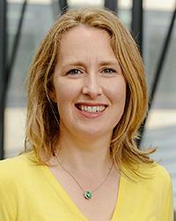
UCD
Student Adviser
Anna Scully
anna.scully@ucd.ie
C1.27 Health Sciences Centre
0871319758

Slide 2
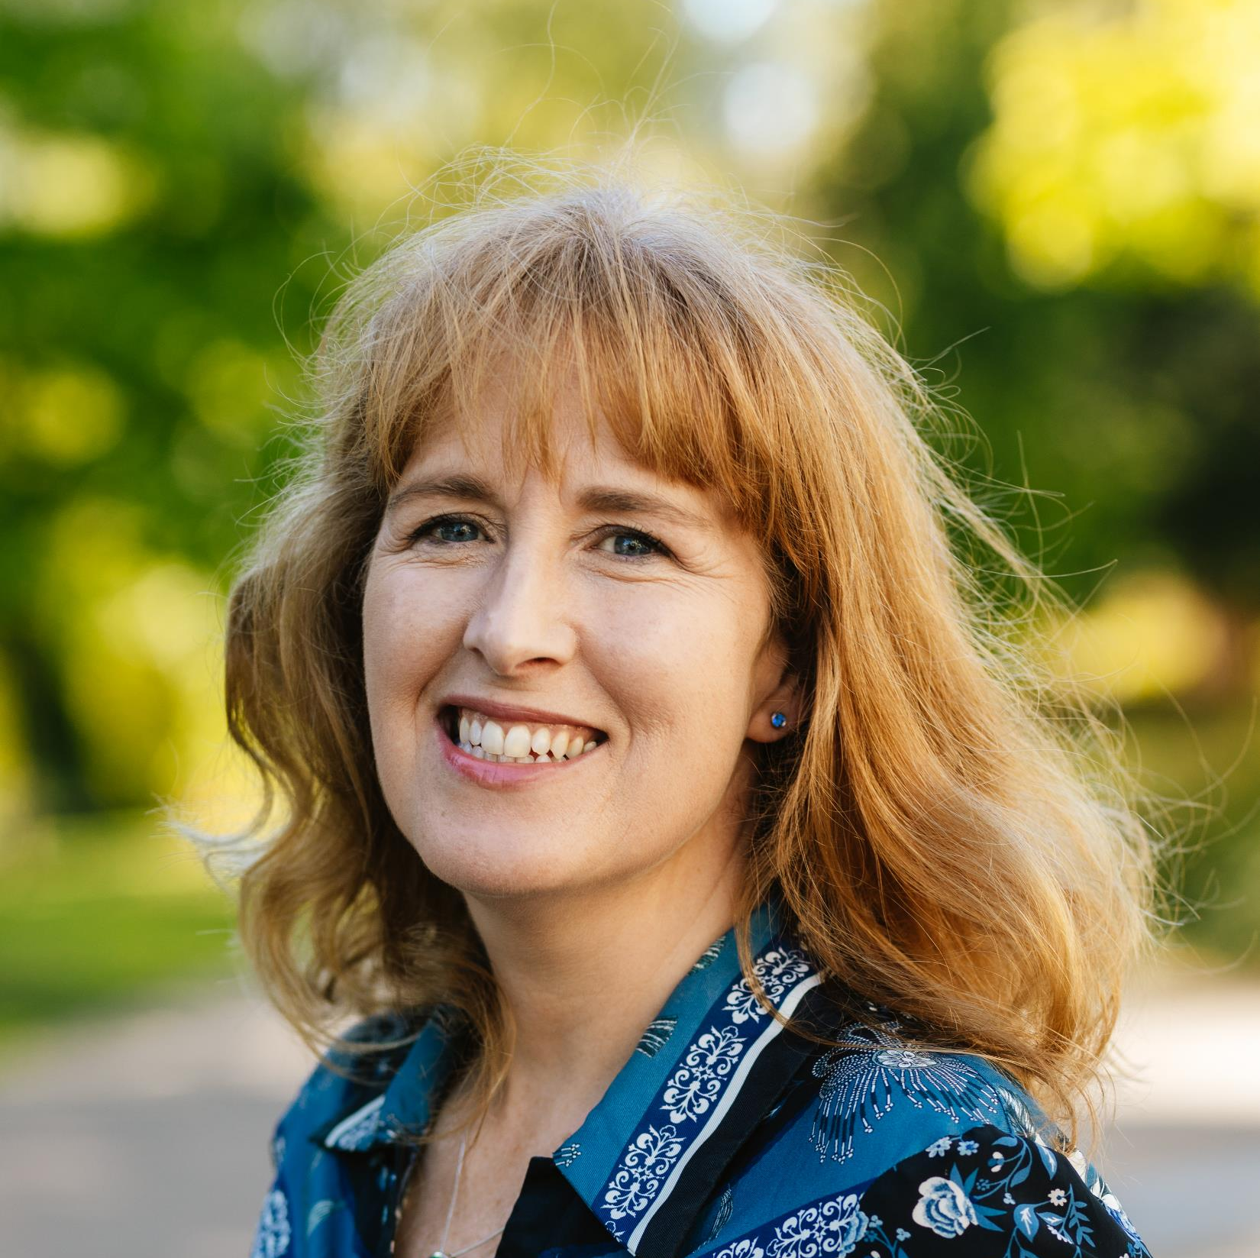
Anna Scully
UCD Student Adviser
Created in 2006
College of Health and Agricultural Sciences :
School of Nursing, Midwifery and Health Systems
School of Public Health, Physiotherapy and Sports Sciences
Student Advisers’ Team is under the Dean of Students, Prof Jason Last in Academic Affairs

Slide 3
Why would I talk to my Student Adviser?
PERSONAL
FINANCIAL WORRIES
FAMILY TROUBLES
STRESS AND ANXIETY
COPING ISSUES
BEREAVEMENT
PRACTICAL CONCERNS
ASSISTANCE WITH UCD POLICIES
REFERRAL TO OTHER SERVICES

Slide 4
Confidential ‘listening ear’
Emotional and Psychological
A Friendly Face! You can come to us with anything – no matter how ‘small’ or how deeply serious the concern.
If you wish to discuss your needs and identify emotional and psychological supports, we can assist you in this process of personal development.
Referral and advice on specialist supports, if you need or choose this.

Slide 5

UCD Student Advisers www.ucd.ie/studentadvisers
Advice on the many other services in UCD that may support you such as Accommodation, Disability Support, Careers Office,
Listening to your concerns we will talk with your School or Programme or other services about your concerns if you wish.
UCD Student Adviser Confidentiality Statement

Slide 6
Assist you navigate UCD policies
Dignity and Respect
Equality, Inclusion and Diversity
Extenuating Circumstances Policy and Student Guide
Leave of Absence
Disciplinary processes eg Student Code, Complaints, Appeals
Plagiarism

Slide 7

Practical assistance
If you are experiencing financial hardship we can support and advise on applying to the
Student EMERGENCY Fund or
Student Support Fund Opens mid October
UCD Financial Information

Slide 8

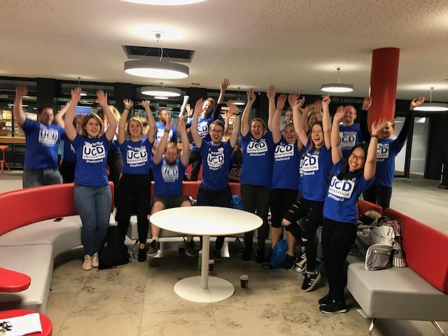
UCD Student Advisers SOCIAL
We support you in creating a community spirit in UCD, for example, at your local School level and through societies, and UCD staff/student committees
We encourage participation in Orientation and other University-wide projects, for example, UCD Volunteers Overseas, Peer Mentoring

Slide 9


‘Get the Balance Right’
Remember to relax and enjoy your time!
Of course, you do need to work as an independent learner and consider your options in academic life.
Don’t forget to take good care of your self, and others around you.
Look out for Wellness events

Slide 10
Access & Lifelong Learning Centre
Disability Support Services
Mature
HEAR
Support for Students who are Parenting fund
Mature Student Adviser Emma Somers

Slide 11
UCD Career Development Centre
This office will hold a series of seminars over the year on many careers
Advice & Information
First office on right as you come to JJL Library building.
Mark.cumisky@ucd.ie

Slide 12
UCD Student Health Centre
Located in the Student Centre, upstairs.. for registered students of UCD ~ Fees apply.
General Practitioners
Nurses
Psychologists/Counsellors ~free of charge
Psychiatrist
Small fees for specialist services..eg travel vaccinations, cervical smears

Slide 13


Slide 14
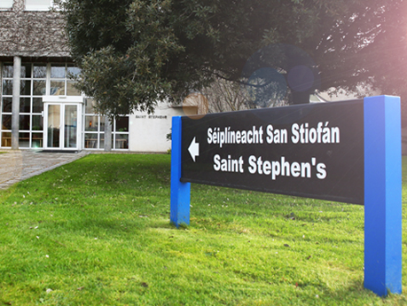
UCD Chaplaincy

Slide 15

Students’ Union Student Societies
& Sport
NAMSOC ( Nursing and Midwifery Society)
nam@ucdsocieties.ie
Auditor : Aoife McEvoy
PhysioSoc physiotherapy@ucdsocieties.ie
https://www.ucdsu.ie/
Tia and Ciara are nursing students !
College officer is healthscience@ucdsu.ie
president@ucdsu.ie

Slide 16


UCD Student Supports
Student Advisers
Student Health – GP, Nurse, Psychiatrist
Counselling service
Addiction Counsellor (AA meetings also on campus)
Chaplains
Access Centre – Disability support
Students’ Union – various officers

Slide 17
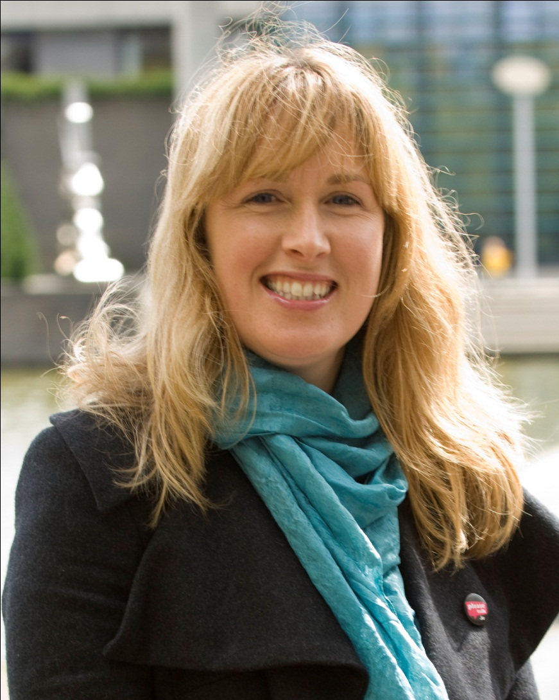
www.ucd.ie/studentadvisers
Anna Scully
UCD Student Adviser
C1.27
Health Sciences Centre
Email anna.scully@ucd.ie
‘phone (01) 716 6497
Mobile 087 131 9758

